Slide 1
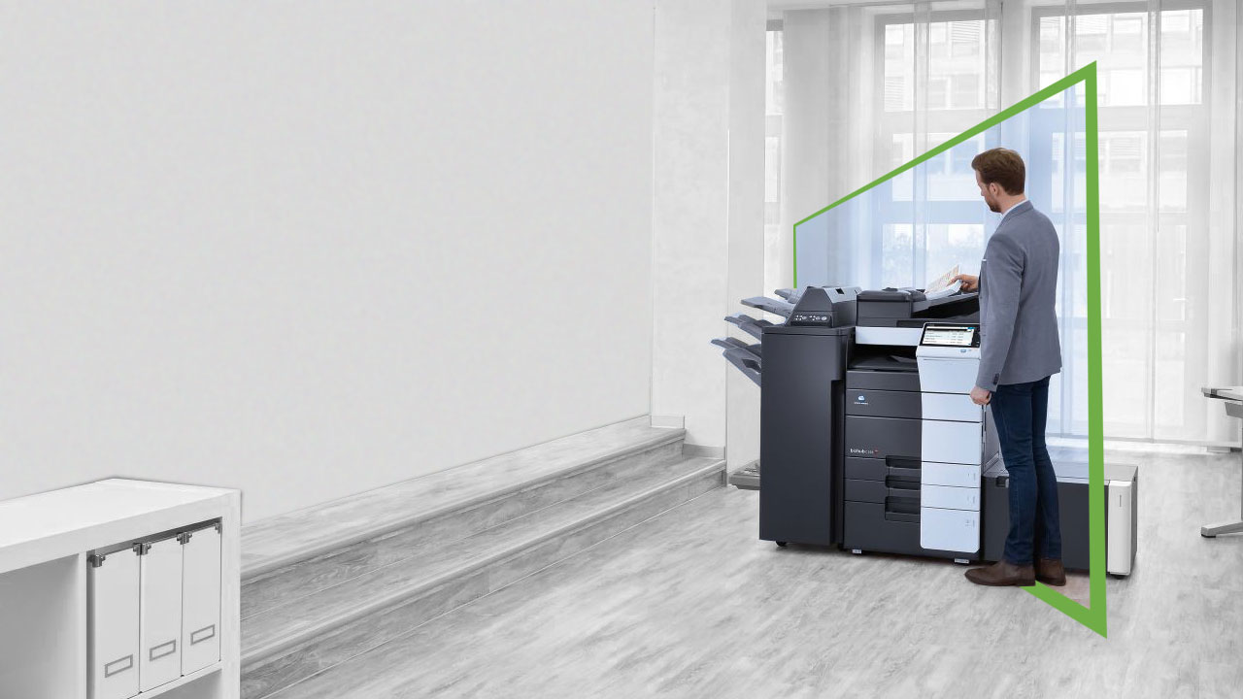
Dispatcher Phoenix Release2Me+ Secure Print Release and Simplified Scanning

Slide 2
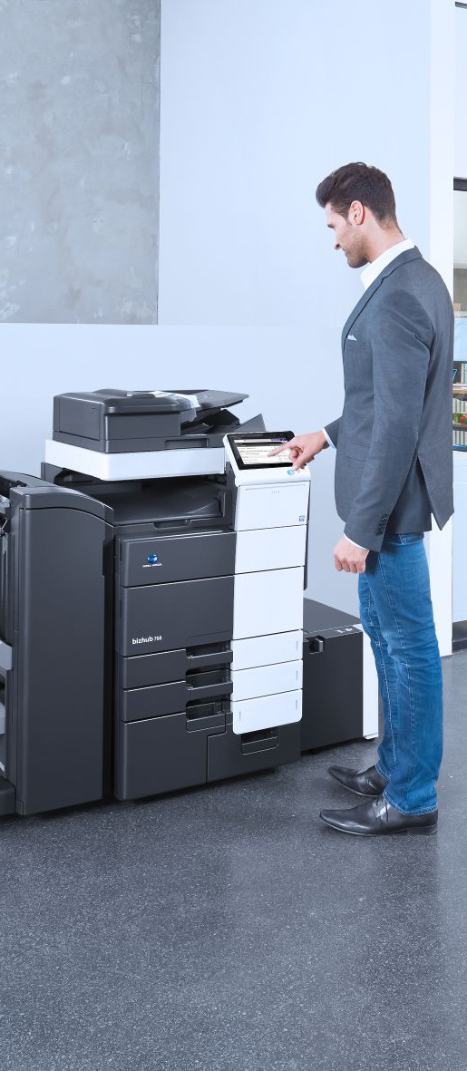
Secure Print Is A Must Have
Unsecure printing leads to exposed private information, wasted paper, and compliance failures
Businesses need a convenient, secure print solution to protect their documents and eliminate unnecessary printing
Most cases, they are forced to buy a full-featured print management solution, with cost accounting, when all they need is secure print!

Slide 3
And Secure Cloud Storage Has Become A Necessity
Poor Document Processes = Widespread Inefficiencies
Nearly half of employees say it’s challenging and time-consuming to find documents they need
83% of workers recreate documents that already exist because they can’t find it on their corporate network!
From 2019 Intelligent Information Management Benchmark Report
https://www.m-files.com/blog/infographic-7-disturbing-document-management-challenges/

Slide 4
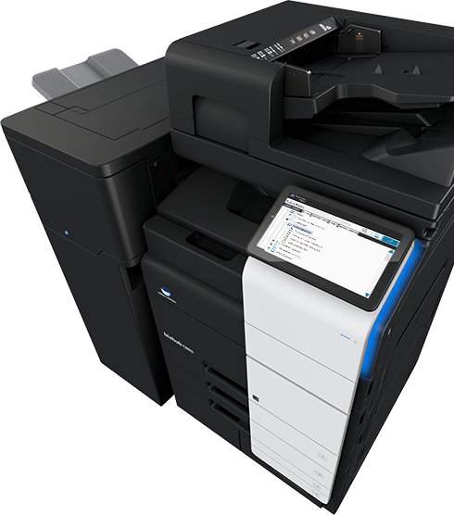
Introducing Dispatcher Phoenix Release2Me+
Dispatcher Phoenix Release2Me+ is a standalone product for secure print release and simplified scanning
With this cost-effective, easy-to-use solution, users can easily:
Secure their print jobs via print queue that is accessed at the MFP after authentication
Generate a variety of print reports to easily access and monitor print activities
Delegate print jobs to other employees
Access a variety of scan workflows at the MFP to help them store and manage their documents, including Scan to Home, Scan to Me, and Scan to the Cloud (Box, Dropbox, OneDrive, SharePoint, Google Drive, WebDAV, and much more)

Slide 5
How Release2Me+ Helps Our Customers
Improves Document Security
Users can choose to print documents from their Release2Me print queue when they are physically present at the MFP
Optimizes Control
Choose when and where you want to print out your confidential documents
Monitor print activity via dynamic, web-based print reports
Reduces Waste
Only print what you need and save on printing costs
Increases Productivity
Improved business operations optimizes time and resources
Streamlines Document Handling
Scan to email, folders, or the cloud…directly from the MFP

Slide 6
Simplified Licensing
Release2Me+ is a stackable license, available in volume discounts at point of purchase
Ordering and configuration is simple…
Choose the number of MFPs PLUS 1 Year of maintenance for each device… and you’re done
Licenses
DP Release2Me+ (1-49 Devices)
DP Release2Me+ (50+ Devices)
DP Release2Me+ (1-49 Devices) 1 year Maintenance
DP Release2Me+ (50+ Devices) 1 Year Maintenance
Upgrade Path: Customers will be able to upgrade their license to a full Dispatcher Phoenix license with a custom quote via SEC Consulting Services
For those customers looking for advanced workflow capabilities with secure follow you printing, the standard Release2Me device licenses are available to add to the Dispatcher Phoenix base license

Slide 7
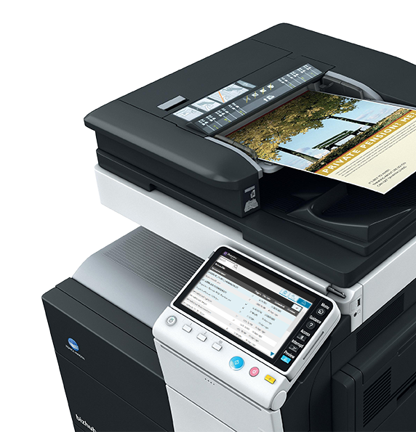
Release2Me+ Summary
Release2Me+ is an ideal solution for businesses that need to secure their print outs and optimize their scanning workflows
Easy-to-use secure print release system and scan-to-cloud workflows help companies advance security in their workflow processes
Any questions? Contact sec@kmbs.konicaminolta.us

